Slide 1


POPULARITY ANALYSIS
OF
SOCIAL BUZZ

Slide 2


Today's agenda
Project recap
Problem
The Analytics team
Process
Insights
Summary

Slide 3

Social buzz I fast growing technology unicorn
That need to adopt quickly to its global scale.
Accenture has begun a 3 month POC focusing on
these tasks:
An audit of Social Buzz’s Big data practice
Recommendation for a successful IPO
Analysis to fine social Buzz’s Top 5 most
popular categories content
Project Recap

Slide 4


Problem
Over 100000 pots per Day
3,650,000 pieces of content
per year!
But hoe to capitalize it when there is so much?
Analysis to find Social Buzz’s top 5 most popular
Categories of content

Slide 5



Andrew Fleming
Chief Technical Architect
The Analytics team
Marcus Rompton
Senior Principle
Vishlesha Walunj
Data Analyst

Slide 6
Process
1
Data Understanding
2
Data Cleaning
3
Data Modelling
4
Data Analysis
5
Uncover Insights

Slide 7
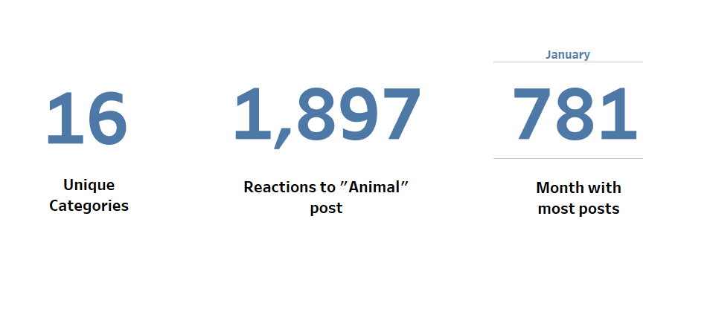

Insights

Slide 8
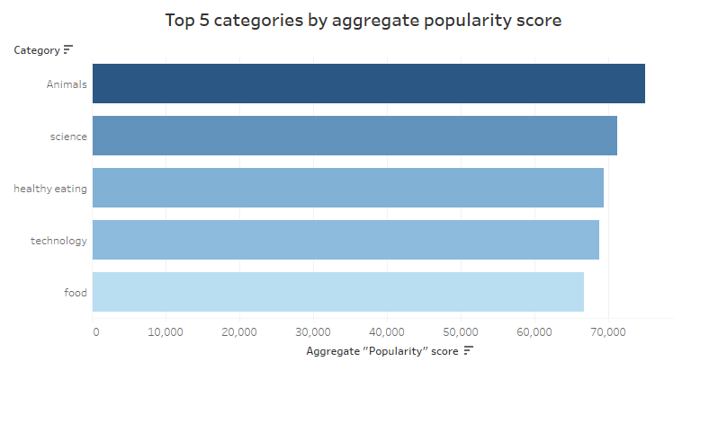

Slide 9
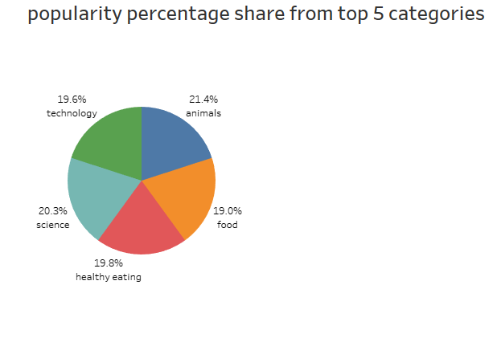

Slide 10

Analysis
Animals and science are the 2 most popular categories of content which shows peoples connection with animals and Science Enthusiasts Flock
Insights
The common theme “Food” in top 5 categories shows the popularity of food-related content which highlights the significant role food plays in our daily lives and social interactions.This insights are helpful in developing creative campaigns and collaboration with food brands to increase engagement.
Summary

Slide 11

Thank you!
ANY QUESTIONS?

